Slide 1
AI,ML | Emotion Detection through speech (worklet ID VI208ITER)
Guided by
Prof. NIVA DAS
STUDENT
Biswakalpita Routray
Shubhaprasad Padhy
Faiza Anwar

Slide 2
What is Emotion Recognition?
Emotion recognition is a method used in software that permits a program to “examine” the sentiments in a human voice happiness, sadness, surprise, anger, etc.
Emotion Recognition from speech
Speech Emotion Recognition (SER) can be defined as extraction of the emotional state of the speaker from his or her speech signal.

Slide 3
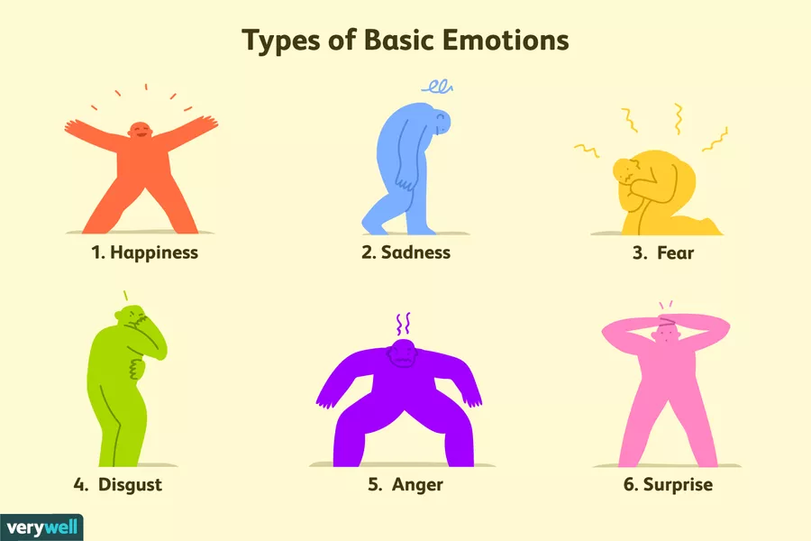
Basic Emotions
ThThis can be used by multiple industries to offer different services like marketing company suggesting you to buy products based on your emotions
is can be used by multiple industries to offer different services like marketing company suggesting you to buy products based on your emotions

Slide 4
Features that help in emotion detection
Mel-frequency cepstral coefficient (MFCC)
Modulation spectral features(MSF)

Slide 5
Applications of SER
Common Applications
Voice to text
Voice commands to smart home devices
Industry applications
Automotive
Media / Marketing
Diagnosis
Business function applications
Customer service
Voice biometrics for security

Slide 6
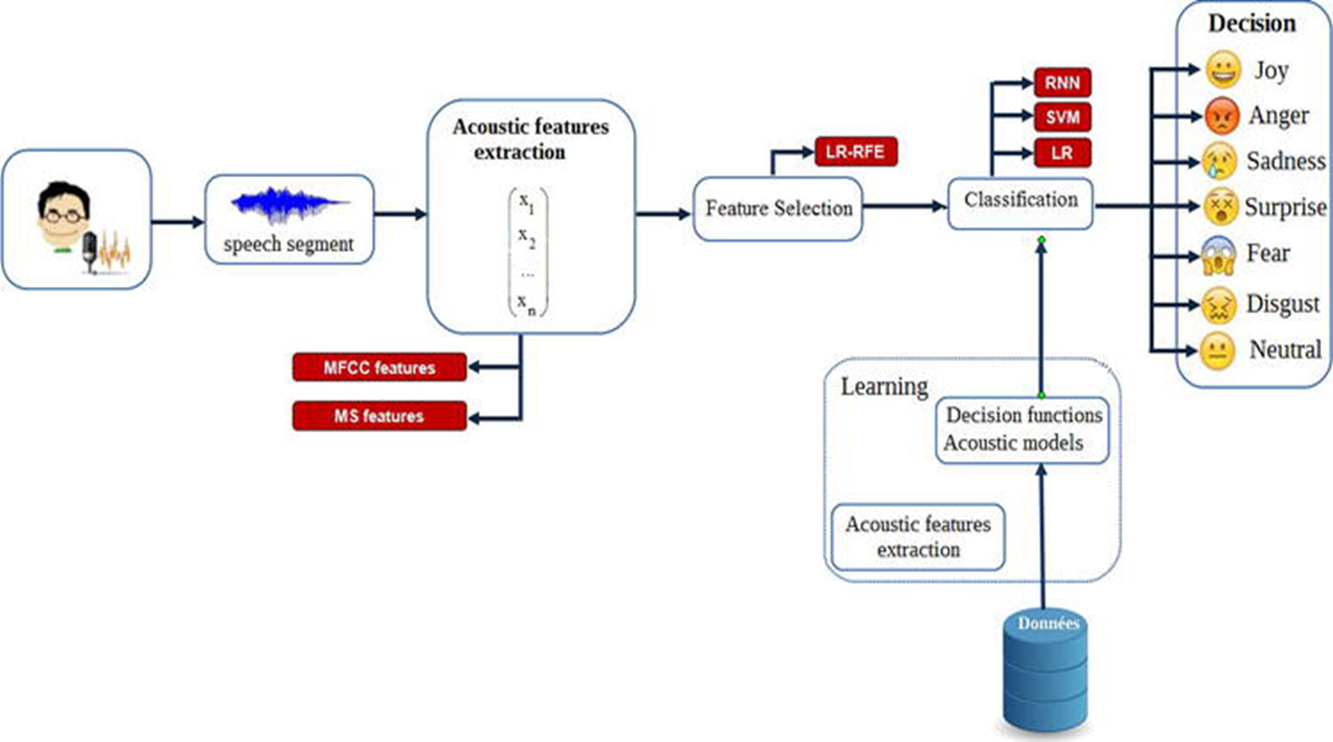

Slide 7
Machine Learning Paradigms
Gaussian mixture model (GMM)
Hidden Markov model (HMM)
Support vector machine (SVM)
Neural networks (NN)
Recurrent neural networks (RNN)
Drawbacks of ML
Most researchers prefer to use combining feature set that is composed of many kinds of features containing more emotional information.
However, using a combining feature set may give rise to high dimension and redundancy of speech features, makes the learning process complicated for most machine learning algorithms and increases the likelihood of overfitting.

Slide 8
Feature extraction is a major component of the machine learning which means that the developer will have to give only relevant information to the algorithm so that it can determine the right solution and to improve the effectiveness of the algorithm. In Deep Learning, raw data can be fed via neural networks and extract high-level features from the raw data.
Machine Learning
Vs
Deep learning

Slide 9
Datasets for SER
Crowd-Sourced Emotional Multimodal Actors Dataset (CREMA-D)
Interactive Emotional Dyadic Motion Capture Database (IEMOCAP)
Vera am Mittag Database (VAM)
Toronto Emotional Speech Set (TESS)
Ryerson Audio-Visual Database of Emotional Speech and Song (RAVDESS)

Slide 10
Upcoming month’s update
Literature Review
Datasets Collection
Speech Features Extraction
ML/DL model to be used

Slide 11
THANK YOU

